Slide 1
IntelliCheck
Intelligent Plagiarism Detector
Explainable similarity detection, built on core algorithms.
Snigdha Patlolla 2510030269
Shravya 2510030123
Dept. of Computer Science & Engineering, KLH University
PBL-4 FINAL REVIEW
Notes:
We built a plagiarism detector without machine learning. It is made of classic algorithms, so every score can be explained and traced back to the text.

Slide 2
Problem & Motivation
PROBLEM
GAP
IMPACT
Manual plagiarism checking is slow and inconsistent
→
Keyword matching misses modified or partially copied text
→
Undetected copying and unfair evaluation
TARGET USERS
Students
Faculty
Teachers
Institutions
IntelliCheck | PBL-4 Final Review
2
Notes:
Faculty cannot read every submission against every source. Simple keyword matching fails when text is reworded or partly copied. We needed something systematic, quick and explainable.

Slide 3
Proposed Solution
Original
(reference)
IntelliCheck
Java analysis engine
Similarity report
Combined score + 4 metrics
Sentence-level breakdown
→
→
Submission
Problem | Our answer
Slow manual review | Upload two files, report in seconds
Keywords miss edits | Edit distance + Jaccard similarity
Opaque scores | Per-metric and per-sentence breakdown
IntelliCheck | PBL-4 Final Review
3
Notes:
Each problem maps to a feature. Exact copying is caught by phrase matching, edits by edit distance, reshuffled words by Jaccard. The combined score is something a teacher can justify.

Slide 4
System Architecture
FRONTEND
Upload .txt files
Run analysis
Report view
HTML · CSS · JavaScript
BACKEND
Preprocessing: cleaning, tokenization
Sentence splitter
Java server API · file-based (no database)
ALGORITHMS
Exact phrase
matching
Edit distance
(DP)
Jaccard
(word sets)
Score combiner
+ sentence analysis
Pure DSA, no ML
IntelliCheck | PBL-4 Final Review
4
Notes:
The browser sends two documents to our Java backend. Text is cleaned and tokenized, then three algorithm families run on it. A combiner weights the scores, and the report returns to the UI.

Slide 5
Technical Implementation: Why These Choices
Component | Why we chose it
Preprocessing & tokenization | Removes noise so comparison focuses on meaningful words
Exact phrase matching (KMP / Rabin–Karp) | Linear-time scan; catches verbatim copied phrases
Edit distance (dynamic programming) | Quantifies how many edits separate two texts; catches light rewording
Jaccard similarity | Set-based; robust to reordered words and sentences
Weighted combined score | Down-weights character-level noise; one interpretable number
Java backend, file-based | Fast string handling; no database overhead for per-session analysis
IntelliCheck | PBL-4 Final Review
5
Notes:
Each algorithm covers a different kind of copying. We chose deterministic algorithms over ML so every score is explainable and needs no training data.

Slide 6
Accuracy & Final Results
14.57%
Combined similarity on an unrelated pair, verdict: LOW (correct)
Test case | Edit | Exact | Jaccard | Combined | Verdict
Unrelated | 26.85% | 0.00% | 4.57% | 14.57% | Low ✔
Identical copy | [ ] | [ ] | [ ] | [ ] | [High]
Lightly edited | [ ] | [ ] | [ ] | [ ] | [ ]
50% copied | [ ] | [ ] | [ ] | [ ] | [ ]
Paraphrased | [ ] | [ ] | [ ] | [ ] | [ ]
IntelliCheck | PBL-4 Final Review
6
Notes:
Here is a real run: two unrelated documents give 14.57% combined, correctly flagged Low. Edit similarity has a natural floor on unrelated text, so the combined score down-weights it. We are adding the remaining test cases.

Slide 7
Innovation & Sustainability
Capability | Keyword match | Single-metric tool | IntelliCheck
Exact phrase detection | ● | ● | ●
Handles edited text | – | Partial | ●
Handles reordered words | – | – | ●
Per-sentence breakdown | – | – | ●
Explainable, no training data | ● | Varies | ●
Runs offline, low compute | ● | Varies | ●
Sustainable by design: low compute · no model retraining · new metrics can be added as modules
IntelliCheck | PBL-4 Final Review
7
Notes:
Our difference is a multi-metric, explainable report instead of one opaque percentage. It is lightweight and cheap to run, so a college can deploy it without special infrastructure.

Slide 8
Utility to Society
Students
Learn originality
Faculty
Save review time
IntelliCheck
Institutions
Consistent, fair evaluation
Academic integrity
Trust in credentials
SCALE PATH
Single pair check
→
Batch of documents
→
LMS integration
→
Institution-wide
IntelliCheck | PBL-4 Final Review
8
Notes:
The main impact is educational: fair assessment and saved review time. Because the system is lightweight, it can scale from one classroom to a whole department.

Slide 9
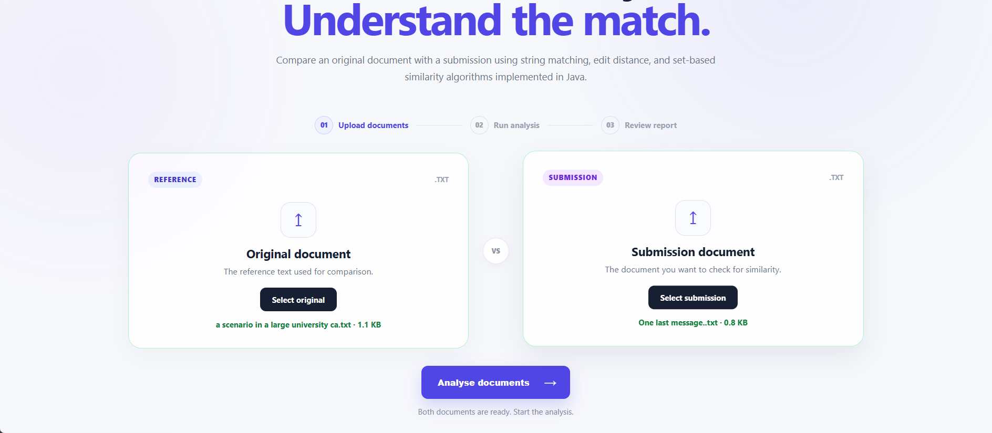
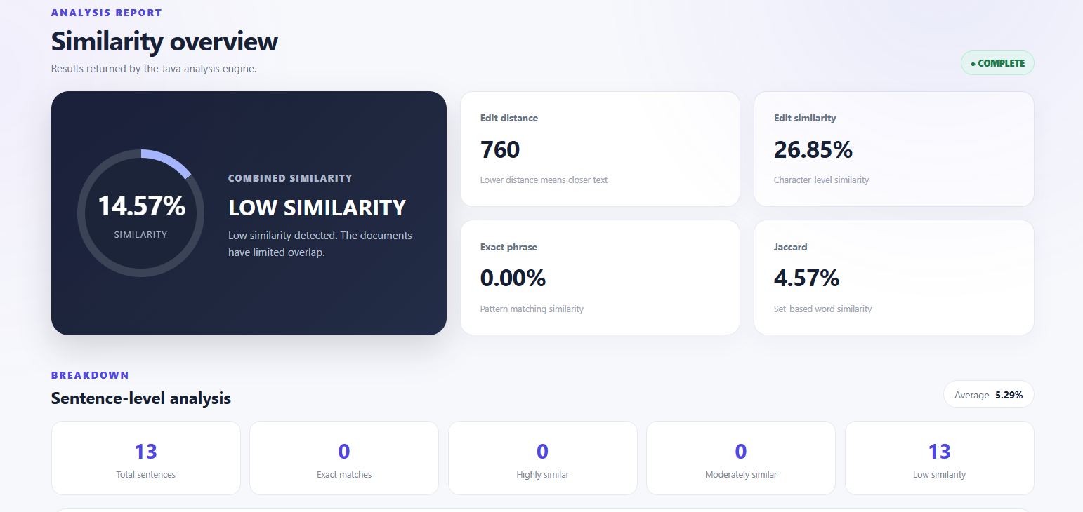
Final Prototype
1 Upload both documents
2 Combined score + four metrics
[Screenshot: sentence-level table]
[Screenshot: high-similarity result]
IntelliCheck | PBL-4 Final Review
9
Notes:
This is the working system: upload both files, run the analysis, then review the combined score and the metrics behind it. Highlight that the report also includes a sentence-level table.

Slide 10
Conclusion & Future Scope
ACHIEVED
FUTURE SCOPE
[Accuracy %]
Semantic similarity
PDF / DOCX support
Web-source comparison
Database for report history
on [N] test pairs
Working Java engine with 3 algorithm families
Combined score + sentence-level report
Web UI with file upload
Explainable plagiarism detection, built from first principles.
Thank You · Questions?
IntelliCheck | PBL-4 Final Review
10
Notes:
We delivered a complete, working system. Next steps are semantic matching and more file formats. We are happy to take questions.

